Slide 1

Machine learning technology for correcting electronic medical texts in Russian
Student: Dmitry Pogrebnoy, J42332c
Supervisor: Sergey Kovalchuk, PhD

Slide 2
Electronic medical records
In healthcare, there are various predictive and decision-making models based on information from patients' medical records
The quality of such models strongly depend on the quality of the source texts
Electronic patient data is usually presented in plain text and contains a lot of spelling errors
Spelling errors in the source texts greatly reduce the quality of the final models and therefore require correction
2/13

Slide 3

Goal and tasks
Goal: Design a method and implement an automatic spelling correction tool for clinical texts in Russian.
Tasks for third semester:
Collect and prepare data for training language models
Select and fine-tune BERT models for ranking task
Conduct extensive testing of the developed tool
Assemble the tool into a package and publish it
3/13

Slide 4
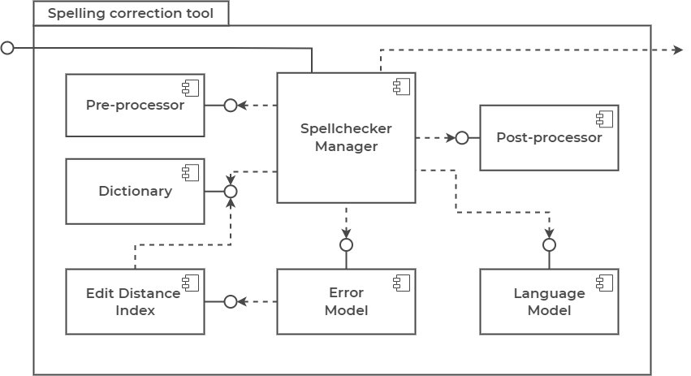
Tool architecture
4/13

Slide 5
Anamneses dataset
Public datasets
RuMedNLI – 14716 records
RuMedPrimeData – 15249 records
Private datasets
Almazov National Medical Research Center – 2355 records
Research Institute of the Russian Academy of Sciences – 161 records
All datasets were pre-processed and assembled into final one
Tokenization and lemmatization
Stop words filtering
5/13

Slide 6
Fine-tune BERT models
sberbank-ai/ruRoberta-large → MedRuRobertaLarge
Size – 1.4 Gb
distilbert-base-multilang-cased → MedDistilBertBaseRuCased
Converted from multilang to Russian model
Size - 217 Mb
cointegrated/rubert-tiny2 → MedRuBertTiny2
Size – 117 Mb
Train/test/eval datasets – 0.8/0.1/0.1
All models are published on the Hugging Face repository
6/13

Slide 7
Word tests internals
Single test - error and lexical precision
100 test sample per each error type
Context test - error and lexical precision
100 test samples per each error type
10 words in each sample
One of ten words is incorrect, other words are correct
Same incorrect words as in single test
Performance
Laptop with Ubuntu 20.04
24 GB RAM and Intel Core i5-10750H CPU @ 1.60GHz * 12
7/13

Slide 8
Single word test
Tool | Error precision | Lexical precision | Average precision | Average words per second
Aspell-python | 0.86 | 0.859 | 0.859 | 283.7
PyHunspell | 0.812 | 0.539 | 0.675 | 9.4
PyEnchant | 0.829 | 0.541 | 0.685 | 20
LanguageTool-python | 0.762 | 0.904 | 0.833 | 25.1
PySpellChecker | 0.354 | 0.86 | 0.607 | 3.4
SymspellPy | 0.399 | 0.813 | 0.606 | 9702.8
Jumspell | 0.267 | 0.947 | 0.607 | 2552.1
Tool (CPU, MedDistilBert) | 0.701 | 0.981 | 0.841 | 12.7
Tool (GPU, MedDistilBert) |  |  |  | 39.7
8/13

Slide 9
Context word test
Tool | Error precision | Lexical precision | Average precision | Average words per second
Aspell-python | 0.739 | 0.93 | 0.835 | 357.3
PyHunspell | 0.706 | 0.719 | 0.713 | 11.8
PyEnchant | 0.721 | 0.719 | 0.72 | 24.3
LanguageTool-python | 0.727 | 0.942 | 0.835 | 43.6
PySpellChecker | 0.304 | 0.868 | 0.586 | 6.7
SymspellPy | 0.37 | 0.913 | 0.642 | 26060.2
Jumspell | 0.307 | 0.969 | 0.638 | 4322.3
Tool (CPU, MedDistilBert) | 0.734 | 0.984 | 0.861 | 45.47
Tool (GPU, MedDistilBert) |  |  |  | 134.453
9/13

Slide 10
Python package
Assembled the pip python package
Package contains
Source code
Dictionary with correct words
No models included
Models are loaded dynamically as needed
Published package name – medspellchecker
10/13

Slide 11
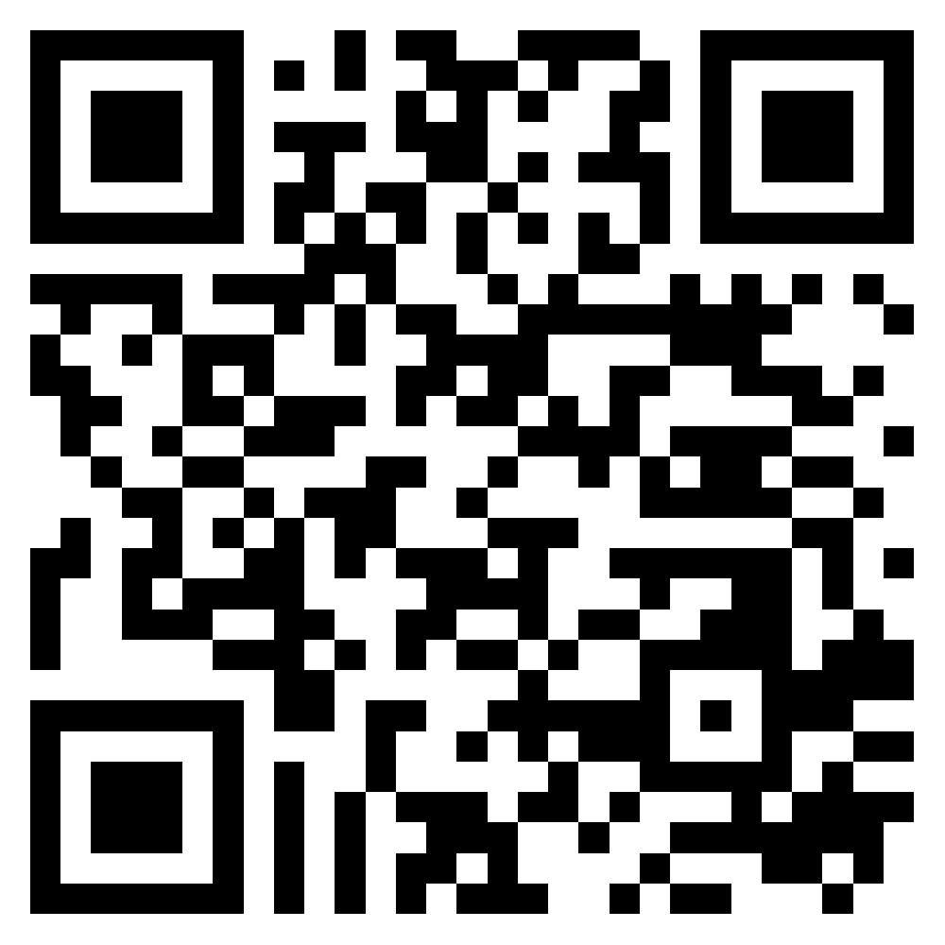
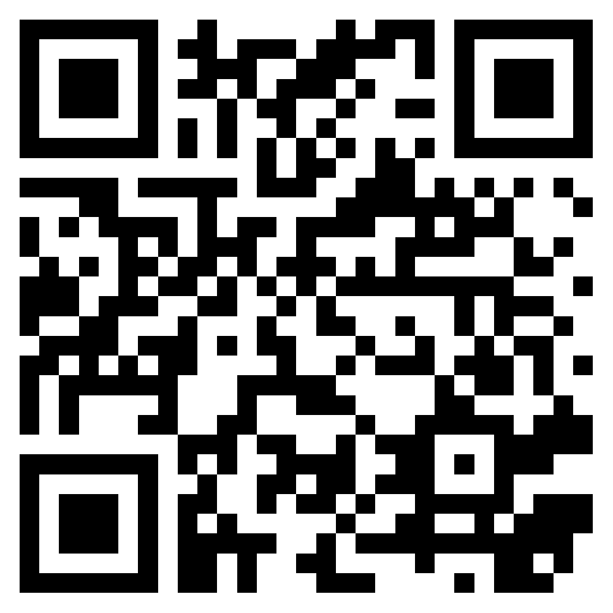
Conclusion
Dataset for training language models is collected
Three different BERT models are fine-tuned for ranking task
Extensive testing of the developed tool is conducted
Package with new tool is assembled
Fine-tuned models
huggingface.co/DmitryPogrebnoy
Pip package
pypi.org/project/medspellchecker
11/13

Slide 12
Further plans
Improve and optimize the spelling correction process
Try to fine-tune smaller language models and test them
Evaluate the effect of the developed tool on medical models
12/13

Slide 13

Thank you for your attention!
Ваши контакты

Slide 14
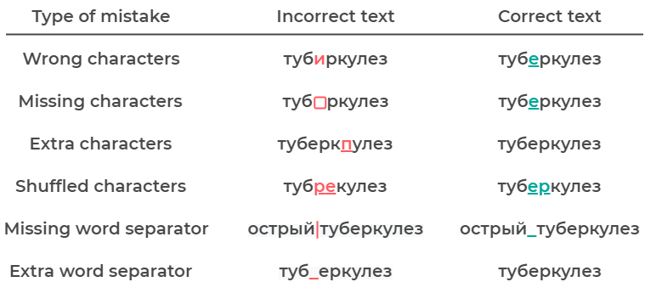
Spelling errors in question
14/13

Slide 15
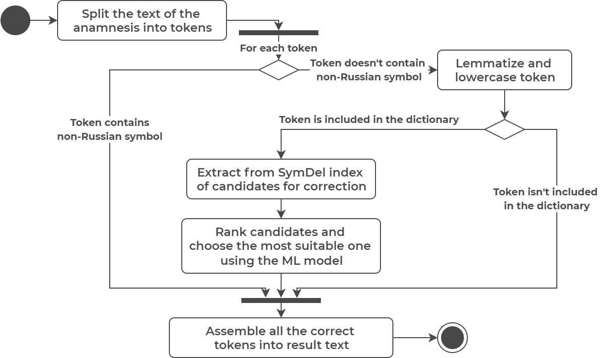
Spelling correction process
15/13

Slide 16
Metrics
Error precision – the ratio of the number of correctly corrected words to the total number of incorrect words
Lexical precision – the ratio of the number of unchanged modified words to the total number of correct words
Average precision – the average of error precision and lexical precision
Performance – the number of words processed by the tool per second
16/13

